Slide 1
Sequence-to-Sequence Spanish Pre-trained Language Models
Vladimir Araujo¹, Maria Mihaela Trusca¹, Rodrigo Tufiño², Marie-Francine Moens¹
¹KU Leuven, ²Universidad Politécnica Salesiana

Slide 2
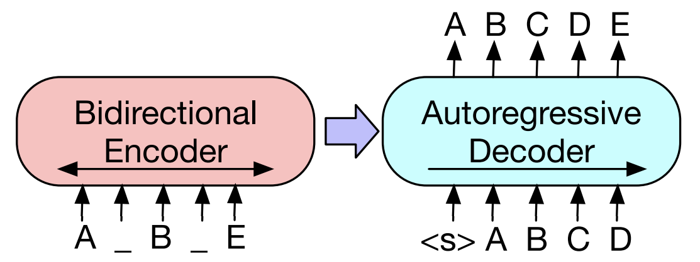
Transformer-based Language Models
Encoder-only model
Transformer encoder + Masked LM
NLU Tasks
Decoder-only model
Transformer decoder + Casual LM
NLG tasks
Encoder-Decoder model
Full transformer model + Denoising objective
Seq2seq tasks (NLU & NLG)
Figures from Lewis et al. (2020)
Notes:
In the contemporary field of NLP, transformer models have been widely used for the development of language models. In terms of architecture, two approaches are prevalent.
On the one hand, encoder-only models which use a transformer encoder and are pretrained using masked language modeling, which consists of masking some tokens of the input to the models predict them. As a result… On the other hand, decoder-only models which use a transformer decoder and use causal language modeling, which consists of predict the next token of a given input. The resulting pretrained models is …
However, there is a third paradigm. The encoder-decoder models use a full transformer architecture with a denoising objective, which consists of representing a corrupt input to the decoder reconstruct it. By pre-training a model with this characteristics, it could be able to solve seq2seq task.

Slide 3
Non-English Language Models
BERT (Devlin et al., 2019)
French (Martin et al., 2020), Dutch (Delobelle et al., 2020), etc.
Spanish (Cañete et al., 2020)
GPT (Radford et al., 2019)
French (Martin et al., 2020, Italian (Mattei et al., 2020), etc.
Spanish (Gutiérrez-Fandiño et al., 2022)
BART (Lewis et al., 2020)
Greek (Evdaimon et al., 2023), Indic (Dabre et al., 2022), French (Kamal Eddine et al., 2021), etc.
Spanish ??
T5 (Raffel et al., 2020)
Portuguese (Carmo et al., 2020), Arabic (Nagoudi et al., 2022), Italian (Sarti and Nissim, 2022), etc.
Spanish ??
We introduce Seq2seq models exclusively pre-trained on Spanish
Notes:
Following the mentioned approaches, several models have been proposed, especially pre-trained with English text.
In the case of encoder-only models, we have the well know model BERT … Regarding decoder-only models, we have GPT the predecessor of the famous ChatGPT … Under the encoder-decoder approach, we find BART and T5 …. However, the availability of Seq2seq models in Spanish remains limited. And this motive us to implement and evaluate pretrained Seq2seq models in Spanish.

Slide 4
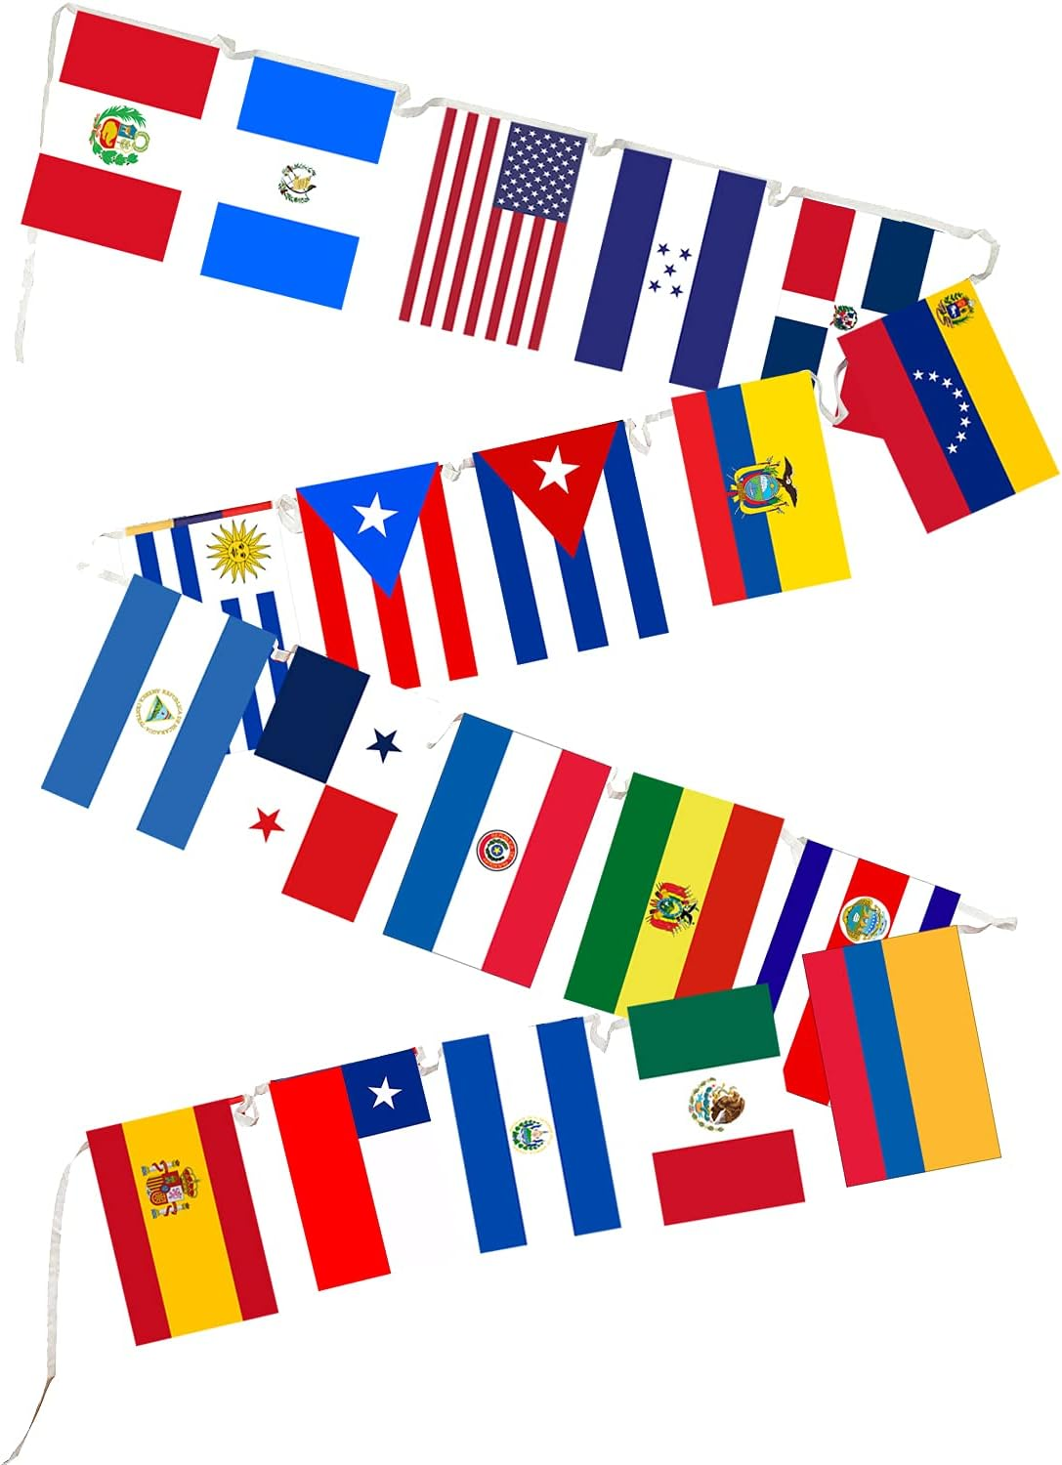
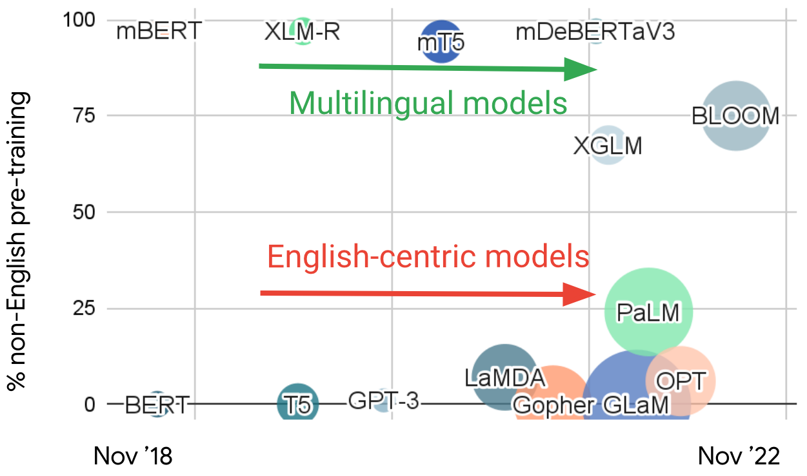
Is it still worth it?
Most recent models are English-centric models
Language-specific models perform better (in some cases (Feijo et al., 2020; Velankar et al., 2022))
Seq2Seq models are the basis for new models:
Reasoning (e.g., COMET (Hwang et al., 2020), ReasonFormer (Zhong et al., 2023))
Processing long sequences (e.g., LED (Beltagy et al., 2020))
Instructional models (e.g., FlanT5 (Chung et al., 2022))
Multimodal models (e.g., KM-BART (Xing et al., 2021))
Promote more research and development in Spanish language
Figure from Ruder. (2022)
Notes:
Before to talk about the methodology of this work, I would like to talk about with this is important. First of all, recent language models are mainly pre-trained with English data. In the graph we can see two different lines of research. One of the models focused on English, which is the one that has shown many advances with many models already available on the market. However, the second line on multilingual or non-English models is still scarce.
Although the graph is a bit outdated, this is still the reality of today's NLP landscape. Secondly, it has been demonstrated that language-specific models perform better than multilingual models, therefore it is valuable to have this kind of models for research.
Regarding Seq2seq models, in the recent years they have been used as the basis for important new models. …………. Finally, this is needed to promote more research and development in Spanish NLP.

Slide 5
Pre-training Dataset
Preprocessing
SUC
Sources
OSCAR 21.09 (Abadji et al., 2022)
mC4 (Xue et al., 2021)
SUC (Cañete et al., 2020)
Wikipedia dump
Preprocessing
Document-level Formatting
Filtering (short and non-Spanish text)
Deduplication
Encoding Correction
Pre-training Data
~28M documents
~120 GB (similar to BART)
Notes:
The first step for pretraining our Spanish models was the collection of a pretraining dataset. We use well-know and open corpora, such as …. Then we carried out a preprocessing stage…. As a result, we obtained a dataset with around 28 million of documents…

Slide 6
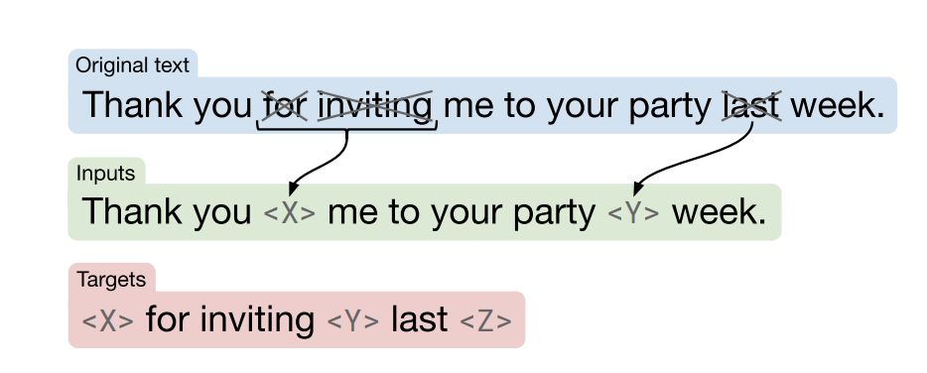
Seq2Seq Spanish PLMs
BARTO
A BART base size model (Lewis et al., 2020).
Pre-trained by denoising corrupted input:
text infilling
sentence permutation
masking 30% of tokens
T5S
A T5.1.1 base size model (Raffel et al., 2020)
Pre-trained by filling in dropped-out spans of text from documents:
corruption rate of 15%
average span length of 3
Figure from Lewis et al., (2020)
Figure from Raffel et al., (2020)
Notes:
In this work, we introduce two seq2seq models.

Slide 7
Baselines
BERT2BERT-style Models
Leverage pre-trained checkpoints to build a Seq2seq PLM (Rothe et al. 2020).
We use Spanish BERT- and RoBERTa-based checkpoints (BETO and RoBERTa-BNE).
We use two configurations:
BERT2BERT
BERTShare
Multilingual Seq2Seq PLMs
mT5-base (Xue et al., 2021)
model pre-trained on 101 languages
mBART-large (Tang et al., 2020)
model pre-trained on 50 languages
Notes:
In order to compare our models, we also include two kind of baselines.
On the one hand, BERT2BERT models…
On the other hand, Multilingual Seq2Seq models..

Slide 8
A Benchmark for Seq2Seq Spanish Models
Abstractive Summarization
MLSUM (Scialom et al., 2020)
WikiLingua (Ladhak et al., 2020)
Long-form Abstractive Summarization
XL-Sum (Hasan et al., 2021)
EURLex-Sum (Aumiller et al., 2022)
Generative Question Answering
MLQA (Lewis et al., 2020b)
SQAC (Gutiérrez Fandiño et al., 2022)
Split-and-Rephrase
BiSECT dataset (Kim et al., 2021)
Dialogue
MIAM (Colombo et al., 2021)
Machine Translation
Fapespv2 (Aziz and Specia, 2011)
WMT13 (Bojar et al., 2013)
Notes:
As there is not an established benchmark for evaluating generative tasks in Spanish, we introduce a compilation of task for evaluating our seq2seq models. We include 6 task.
AS: which consists of summarizing a text in a few sentences.
LFAS: which involves processing or generating longer sequences. GQA: which aims to answer a question given a context text. SaP: which is a simplification task that gives a very long sentence to be split in shorter ones. Dialogue: which consist of generating a response from a dialogue context.
MT: which in this case aims to translate from spanish to portugues or English and viceversa.

Slide 9
Results and Findings: Generative Tasks
BARTO and T5S outperform BERT2BERT-style and multilingual models
Our models are superior to BERT2BERT-style models (Long-form summarization and QA)
BARTO works better for dialogue and T5S is better for simplifying text.
Notes:
In this graph we show the result of all the models in all the tasks, where the 2 bars on the right of each group present the results of our models. We found that BARTO and T5S outperform BERT2BERT models and multilingual models in the majority of the cases. There is a big gap between seq2seq and bert2bert models in terms of performance, especially on long form summarization and generative QA. This demonstrates the strong capacity of s2s models for these complex tasks. Finally we found that barto perfom the best for dialogue, and surprisingly BERT2BERT as well. While T5S is better for simplifying text.

Slide 10
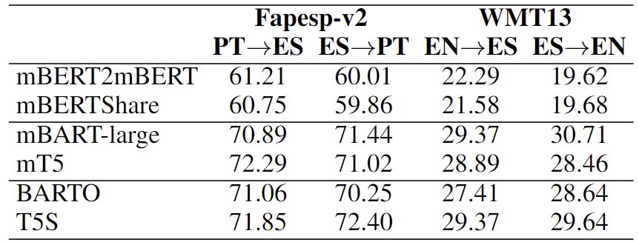
Results and Findings: Machine Translation
Competitive against multilingual Seq2seq models in Machine Translation
BARTO and T5S can be fine-tuned for translation without additional mechanisms (Lewis et al. 2020a)
Our corpora consists of at least 98% accuracy for Spanish language prediction
Our models acquired knowledge of other languages often found alongside Spanish
Notes:
Regarding the machine translation task, our experiments evaluate the translation from Spanish to Portuguese and English and vice versa. We found …

Slide 11
Results and Findings: Discriminative Tasks
Evaluation on discriminative tasks
GLUES (Cañete et al., 2020)
Semantic Similarity (Gutiérrez Fandiño et al., 2022) and Relatedness (Ousidhoum et al., 2024)
SQAC (Gutiérrez Fandiño et al., 2022)
BARTO and T5S perform competitively
Especially when processing long sequences
BARTO outperforms in STS and STR

Slide 12
Conclusions
We introduced BARTO and T5S
We introduced a benchmark for evaluation with generative tasks
BARTO and T5S outperform multilingual and BERT2BERT-style models
Better performance when processing long sequences
Can be used for machine translation using high resource languages
Models available to facilitate future research and practical applications in Spanish NLP: https://github.com/vgaraujov/Seq2Seq-Spanish-PLMs

Slide 13
Thank you
ACK: European Research Council and Google Cloud Research Credits program

Slide 14
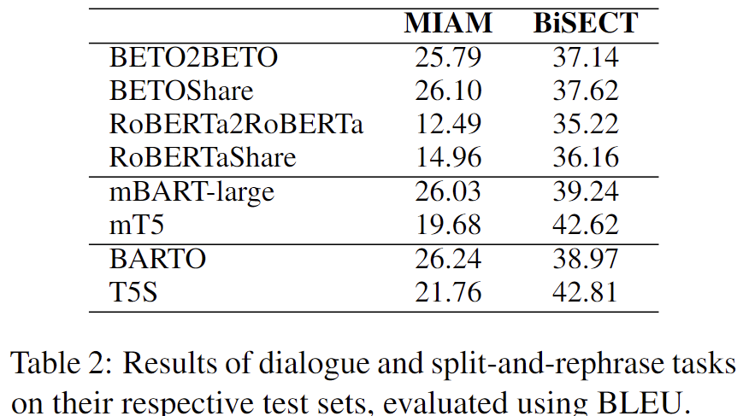
Results and Findings
BARTO and T5S outperform BERT2BERT-style and multilingual models
Big gap on QA between Seq2seq models and BERT2BERT-style models
BARTO performs the best for dialogue
T5S better for simplifying text

